Slide 1

Downturn Insurance
A Case for Restructuring Services
Jo Mitchell-Marais

Slide 2

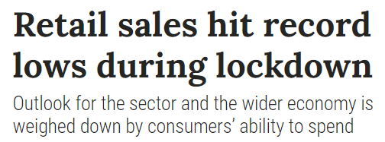
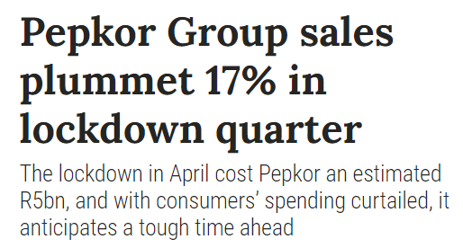
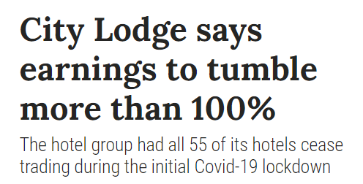
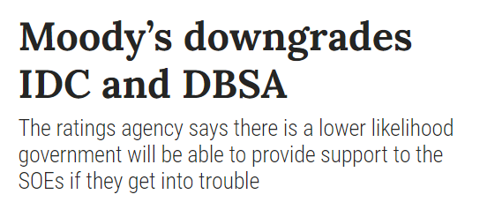

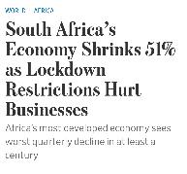
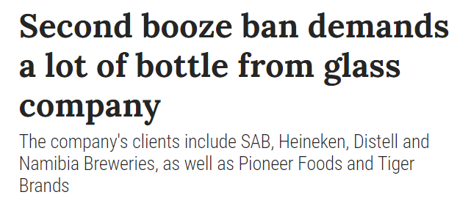
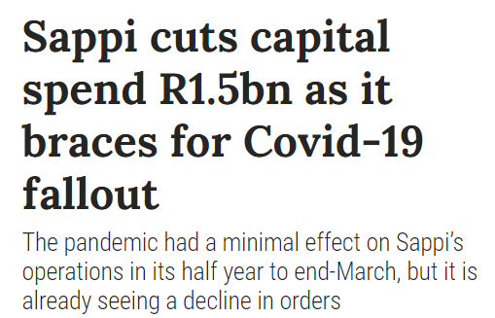
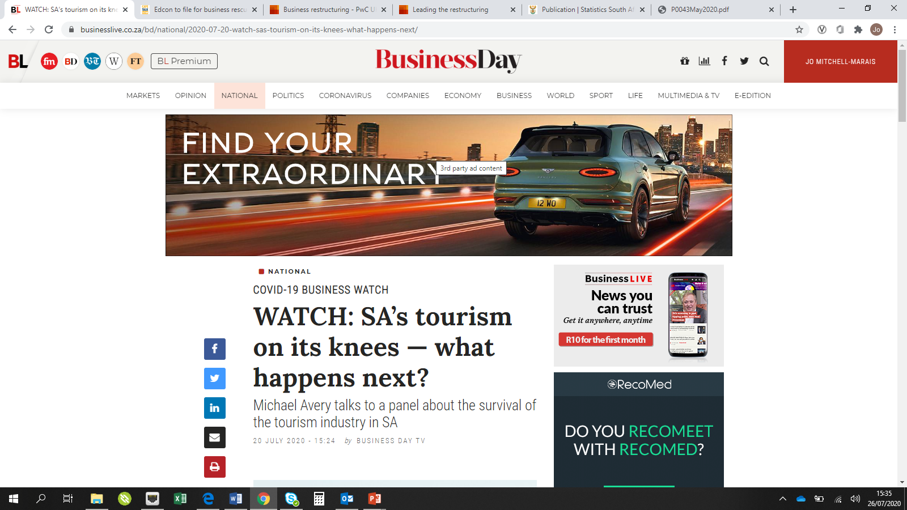
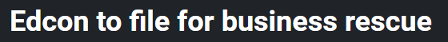
A snapshot of headlines over the past 10 months
01
02
03
04

Slide 3
Covid has wreaked havoc on our already fragile economy.
Pre-existing financial conditions will make it harder for companies to survive the economic fallout from the pandemic
Our clients, although resilient, are not immune and need our help
01
02
03
04
05
06
07

Slide 4
Cash preservation is the number one priority of companies facing uncertainty and / or experiencing distress
Discretionary spend, capex projects, potential acquisitions are being postponed or abandoned
This has the potential to impact Deloitte
01
02
03
04
05
06
07

Slide 5
Restructuring Services and the DMO can provide limited downside protection
Counter-cyclical business unit
Walking alongside our clients and assisting them through these tough times, creates lasting loyalty and really creates an impact that matters
01
02
03
04
05
06
07

Slide 6
RS toolkit can be relevant to a company anywhere along a broad spectrum of circumstances & requires multi-disciplinary teams to deliver
01
02
03
Level of influence
04
Value Creation Services
Managed-Exit
05
Working Capital Management & Optimisation
Financial Restructuring Advisory
Restructuring Advisor
06
Cash Management
Negotiation
07
Options Analysis
IBR
Contingency Planning
Options Analysis
Turnaround Plan
Executive-Support
Insolvency
CRO
Liquidation Estimated Outcome Statement
Management-led
Creditor-led

Slide 7

Disrupted: refresh, rethink, redesign
Disadvantaged: reset, rebalance, reconfigure
Distressed: reconnect, reconstruct, restore
01
02
03
04
05
Disrupted
06
07
Disadvantaged
Distressed

Slide 8
Problem Statement: personal contribution for success & sustainability
Leadership
Team: flexibility, partnerships & alliances, tilt skillset
DMO: identify opportunities, early-stage interventions, robust CoP
01
02
03
04
05
06
07

Slide 9
Downturn Insurance
A Case for Restructuring Services
Jo Mitchell-Marais

